Slide 1
An Introduction to Cloud Computing

Slide 2
Agenda – Topics
Topic | Name of Topic
1 | Introduction to Cloud Computing
1.1 | Definition of Cloud Computing
1.2 | Deployment Models
1.3 | History of Cloud Computing
2 | Rationale for the Cloud
3 | Case Scenarios for Cloud Computing
3.1 | IoT – the Internet of Things
3.2 | Big Data
4 | Cloud Computing Technologies
4.1 | Infrastructure as a Service
4.2 | Platform as a Service
4.3 | Database as a Service
4.4 | Example for Cloud Use Case: Machine Learning
5 | Designing Cloud Applications
6 | Cloud Metrics
7 | Cloud Computing Scenarios

Slide 3
1 Introduction to Cloud Computing
1.1 Definition of Cloud Computing
1.2 Deployment Models
1.3 History of Cloud Computing

Slide 4



What is „the cloud“? What people used to say:
❶ “The interesting thing about cloud computing is that we’ve redefined cloud computing to include everything that we already do.... I don't understand what we would do differently in the light of cloud computing other than change the wording of some of our ads.”
(Larry Ellison, CEO Oracle, Wall Street Journal, September 26, 2008)
❷ “A lot of people are jumping on the [cloud] bandwagon, but I have not heard two people say the same thing about it. There are multiple definitions out there of “<the cloud.’”
(Andy Isherwood, HP VP, www.zdnet.de, December 11, 2008)
❸ “lt’s stupidity. lt’s worse than stupidity: it’s a marketing hype campaign. Somebody is saying this is inevitable – and whenever you hear somebody saying that, it’s very likely to be a set of businesses campaigning to make it true.”
(Richard Stallman, The Guardian, September 29, 2008)
Source: “Cloud Computing & Pricing,” Otto-von-Guericke-Universität Magdeburg, Fakultät für Informatik, Robert Neuman, p.29

Slide 5
1.1 Definition of Cloud Computing
A Berkeley View of Cloud Computing
The NIST Definition of Cloud Computing
Examples of Cloud Computing Technologies
Multitenancy

Slide 6



A Berkeley View of Cloud Computing
❶ The illusion of infinite computing resources available on demand, thereby eliminating the need for cloud computing users to plan far ahead for provisioning
❷ The elimination of an up-front commitment by cloud users, thereby allowing companies to start small and increase hardware resources only when there is an increase in their needs
❸ The ability to pay for the use of computing resources on a short-term basis as needed (e.g., processors by the hour and storage by the day) and release them as needed, thereby rewarding conservation by letting machines and storage go when they are no longer useful
Source: “Above the Clouds: A Berkeley View of Cloud Computing,” 2009, https://www.eecs.berkeley.edu/Pubs/TechRpts/2009/EECS-2009-28.pdf

Slide 7
The NIST Definition of Cloud Computing
Characteristics
Service models
Deployment models
On-demand self-service
Broad network access
Resource pooling
Rapid elasticity
Measured service
Software as a Service (SaaS)
Platform as a Service (PaaS)
Infrastructure as a Service (IaaS)
Private cloud
Community cloud
Public cloud
Hybrid cloud
Source: “The NIST Definition of Cloud Computing,” 2011, http://nvlpubs.nist.gov/nistpubs/Legacy/SP/nistspecialpublication800-145.pdf
Notes:
NIST National Institute of Standards and Technology, U.S. Department of Commerce

Slide 8




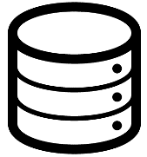

Examples of Cloud Computing Technologies
Web Services
Business Model
Virtualization
Compute
Data
Products
SOAP
JSON
REST
…
On-demand
Pay as you go
Spot instances
…
Full
Para
VMware
Hyper-V
Xen
…
Scale-out
Distributed
Failover
Load balancing
…
RDBMS
NoSQL
Column stores
MapReduce
…
Microsoft Azure
Amazon Web Services
Google Compute Engine
…
Cloud Computing ≠ Hosting
Source: “Cloud Computing & Pricing,” Otto-von-Guericke-Universität Magdeburg, Fakultät für Informatik, Robert Neuman, p.28

Slide 9







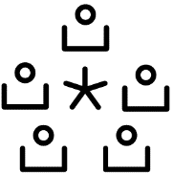
PaaS
Elasticity
IaaS
SaaS
Private
Reliability
Public
TYPES
Virtualization
Hybrid
…
FEATURES
MODES
…
Cost reduction
Local
Ease of use
BENEFITS
Cloud
systems
LOCALITY
Remote
…
Distributed
COMPARES TO
STAKEHOLDERS
Service-oriented
architecture
Users
Internet of services
…
Providers
Adopters
Grid
Resellers
Source: “The Future Of Cloud Computing,” Expert Group Report, http://cordis.europa.eu/fp7/ict/ssai/docs/cloud-report-final.pdf

Slide 10
Multitenancy
Definition
Single instance of software runs on a server serving multiple clients (tenants)
Applications are able to virtually partition tenant data and logic
Multitenancy economies
Cost savings (per tenant, on-demand/as you go)
Harder to develop due to higher complexity
Eased release management
Opposite of multi-instance architecture
Each tenant runs its own instance
Source: “Cloud Computing & Pricing,” Otto-von-Guericke-Universität Magdeburg, Fakultät für Informatik, Robert Neuman, p.34

Slide 11
1.2 Deployment Models
Public, Private and Hybrid Cloud
Economics of the Cloud
Decision Criteria for Introducing Cloud Services
Reasons to Consider Cloud Computing According to Bitkom
A Mix of Standard Components & Custom Software

Slide 12

Deployment Models
User organization A
Hybrid cloud
Vendor organization X
User organization B
Private
Cloud
Private
cloud
Public
cloud
Private
cloud
Vendor organization Y
“The cloud”
User organization C
Vendor organization Z
Public
cloud
Public
cloud
Private
cloud
Public
cloud
Source: “Cluster-, Grid- und Cloud-Computing,” Hochschule Mannheim, Christian Baun, 2010

Slide 13

Private Cloud
Vendor and users belong to the same organization
Services should be compatible with established public cloud vendors
No risk of vendor lock-in
Data security is in the hands of the user
Almost the same cost for hardware, space, and administration as for non- cloud-based architectures
Private
cloud
Source: “Cluster-, Grid- und Cloud-Computing,” Hochschule Mannheim, Christian Baun, 2010

Slide 14
Public Cloud
Vendor and users belong to different organizations
Vendors pursue commercial interests
Users do not have to invest in procurement, operation, and maintenance of hardware
Public cloud services are outside the user’s firewall
Theoretical risk of vendor lock-in
Data protection and data security standards of the vendor need to be taken into account
Public
cloud
Source: “Cluster-, Grid- und Cloud-Computing,” Hochschule Mannheim, Christian Baun, 2010

Slide 15
Hybrid Cloud
Services from public and private clouds are used together in the same infrastructure
Examples of use
Cover peak loads on self-hosted infrastructure with public clouds
Backup of data in public clouds
Use scale of public cloud and security standards of private clouds together
Hybrid
cloud
Hybrid
Cloud
Source: “Cluster-, Grid- und Cloud-Computing,” Hochschule Mannheim, Christian Baun, 2010

Slide 16
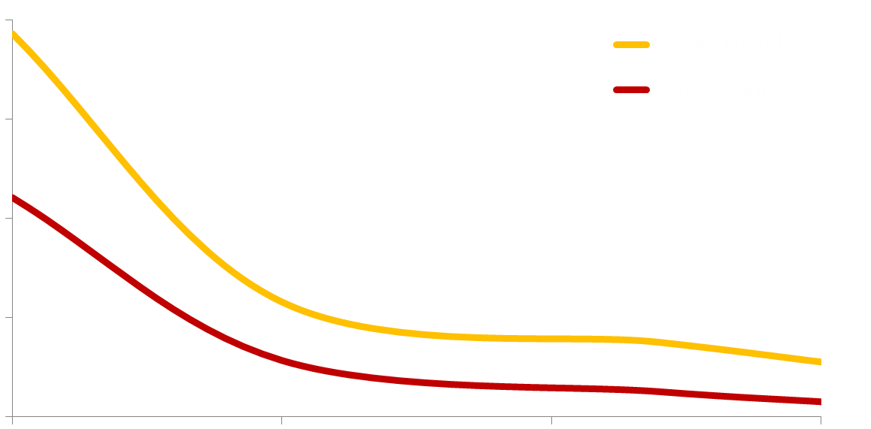
Economics of the Cloud
Private vs. public cloud
$8,000
Private cloud
Public cloud
$6,000
$2,000
$TCO/10% server workload
$1,000
$0
100
1,000
10,000
100,000
# of servers in data center
Source: Microsoft

Slide 17
Decision Criteria for Introducing Cloud Services
In favor of cloud computing
Against cloud computing
Small IT budget
Use of commodity/standardized solutions
Small operations team or knowledge
Own IT is differentiator
Low degree of automation and industrialization
Specific compliance regulations that require own infrastructure
Source: “Service Engineering,” Otto-von-Guericke-Universität Magdeburg, Andreas Schmietendorf, 2012, p.30

Slide 18
Reasons to Consider Cloud Computing According to Bitkom
Focus on core business instead of IT operations
Standardized, up-to-date, and consolidated IT
Moving CAPEX to OPEX
Becoming more flexible
Transferring investments, risk, and human resources to a vendor
Reliable availability and high level of security
Source: Bitkom, https://www.bitkom.org/Bitkom/Publikationen/Eckpunkte-fuer-sicheres-Cloud-Computing.html, 2013

Slide 19



A Mix of Standard Components & Custom Software
SaaS solutions
Differentiation
Cloud infrastructure
Agility
Higher-level services
Cost
Source: Microsoft

Slide 20
1.3 History of Cloud Computing
From Single to Multi-threaded Execution
From Multi-threaded to Multi-core Execution
Multi-threaded + Multi-core + Multi-machine = PaaS

Slide 21


From Single to Multi-threaded Execution
Program
Program
Processor
Processor
Thread 1
Thread 1
Thread 2
1990
1995
2000
2005
Source: “Cloud Computing,” Frankfurt University of Applied Sciences, Damir Dobric, p.6​

Slide 22
From Multi-threaded to Multi-core Execution
Program
Processor – core I
Processor – core II
Thread 1
Thread 2
Thread 1
Thread 2
2005
2010
2015
today
Source: “Cloud Computing,” Frankfurt University of Applied Sciences, Damir Dobric, p.8​

Slide 23

Multi-threaded + Multi-core + Multi-machine = PaaS
A program running on a cloud platform
Machine I
Machine II
Machine X
Processor – core I
Processor – core II
Processor – core I
Processor – core II
Processor – core I
Processor – core II
Thread 1
Thread 2
Thread 1
Thread 2
Thread 1
Thread 2
Thread 1
Thread 2
Thread 1
Thread 2
Thread 1
Thread 2
Processor – core III
Processor – core IV
Processor – core III
Processor – core IV
Processor – core III
Processor – core IV
Thread 1
Thread 2
Thread 1
Thread 2
Thread 1
Thread 2
Thread 1
Thread 2
Thread 1
Thread 2
Thread 1
Thread 2
Cloud Computing Platforms
Source: “Cloud Computing,” Frankfurt University of Applied Sciences, Damir Dobric, p.10​

Slide 24
2 Rationale for the Cloud

Slide 25

Why the Cloud?
Rapidly set-up environments
Scale to meet peak demands
Increase daily activities, efficiency, and reduced cost
Speed
Scale
Economics
Source: Microsoft

Slide 26
Pre-cloud Provisioning
Provisioned IT
capacity
Load forecast
Underbuy
Fixed cost for capacity
IT capacity
Overbuy
Investment hurdle
Real load
Time
Source: “Cloud Computing & Pricing,” Otto-von-Guericke-Universität Magdeburg, Robert Neuman, p.31

Slide 27
Cloud Elasticity (Provisioning)
Provisioned IT
capacity
Elimination of underbuy
Load forecast
IT capacity
Reduction of capacity with declining load
Reduction of overbuy
Lower initial investment
Real load
Time
Source: “Cloud Computing & Pricing,” Otto-von-Guericke-Universität Magdeburg, Robert Neuman, p.32

Slide 28
Computing Patterns
Inactivity
period
Compute
t
On and off
Growing fast
Unpredictable bursting
Predictable bursting
24/7 Steady
Capacity needed (Max. + 20%)
Capacity needed (Max. + 20%)
Save
20–30%
Save
60–80%
S M T W T F S
J F M A M J J A S O N D
Typical IT portfolio:
On and off
(30%)
Growing fast
(15%)
Unpredictable bursting
(25%)
Predictable bursting
(20%)
24/7 Steady
(10%)
Source: Microsoft

Slide 29
3 Cloud Computing Case Scenarios
3.1 IoT – the Internet of Things
3.2 Big Data

Slide 30
3.1 IoT – the Internet of Things

Slide 31

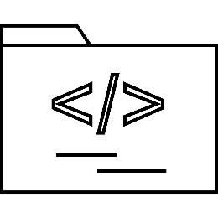
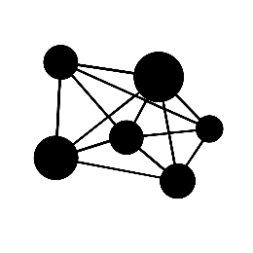
Why Now?
Huge number of connected devices
High-level software in microcontrollers
New connectivity approaches
Devices produce data (Big Data)
We can build information from Big Data
Lower development costs
Huge community of developers
(Almost) Any solution/app can compatibly participate
Web provides out-of-the-box connectivity
Cloud platform provides new possibilities
Source: “Software Engineering,” IoT Lecture, Frankfurt University of Applied Sciences, Damir Dobric, p.8​

Slide 32






IoT Device Taxonomy
Large
POS terminal, ATM, MRI
x86, PC-like, apps
Embedded Industry 8.1, Standard
Large
Mobile
Industry handheld, POS tablet
ARM and x86, shell experience, apps
Embedded Handheld 8.1
Mobile
Small
Gateways, wearables, panels, cars
ARM and x86, diverse hardware, no shell
Embedded Compact, Auto
Small
Micro
Controllers, fixed-use, sensors, actuators
ARM, constrained hardware, headless
.NET Micro Framework
Micro
Source: “Software Engineering,” IoT Lecture, Frankfurt University of Applied Sciences, Damir Dobric, p.20​

Slide 33
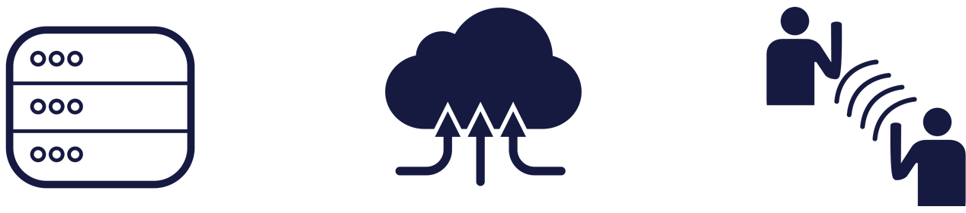
Challenges of the Internet of Things
Huge data ingress – how do we handle
gigabytes of data coming from
billions of devices and sensors
within a few seconds?
Big Data – how do we make use of
terabytes of data
from a long period of time
to learn about the past
and predict the future
in an easy way?
Communication – how do we
send a command to these devices
and deploy new software
and maintenance updates?
Source: Microsoft

Slide 34


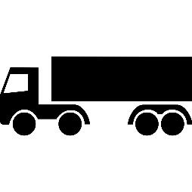








We Are Already Part of a Cloud
Source: “Software Engineering,” IoT Lecture, Frankfurt University of Applied Sciences, Damir Dobric, p.15​

Slide 35
3.2 Big Data
What is Big Data?
Big Data Analytics
Big Data Technologies

Slide 36
What is Big Data?
Internet of Things
Exabytes
(10e18)
Social sentiment
Click stream
Sensors/RFID/devices
Wikis/blogs
Modern Web
Audio/video
Petabytes
(10e15)
Mobile
Log files
Advertising
eCommerce
Collaboration
Spatial & GPS coordinates
Volume
ERP/CRM
Digital marketing
Terabytes
(10e12)
Data market feeds
Payables
Contacts
Search marketing
eGov feeds
Payroll
Deal tracking
Web logs
Weather
Gigabytes
(10e9)
Inventory
Sales pipeline
Recommendations
Text/image
Velocity | Variety | Variability
ERP/CRM
Modern web
Internet of Things
Source: Microsoft

Slide 37

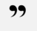
Big Data Analytics
It takes more time to hand a project from the seismic guys to me to the engineers in production than it does to figure out the oil field plays.
Geologist, Major oil and gas company
Data
acquisition
& modeling
Collaboration
&
visualization
Our weather model and resulting data sets should be accessible to universities and other institutions.
Aerospace Development Manager, U.S. Federal Government
Dissemination, sharing, preservation
Analysis & data mining
Source: Microsoft

Slide 38
Big Data Technologies
Data size
Gigabytes (Terabytes)
Petabytes (Hexabytes)
Access
Interactive and batch
Batch
Read/write many times
Write once, read many times
Updates
Structure
Static schema
Dynamic schema
Integrity
High (ACID)
Low
Scaling
Nonlinear
Linear
Source: Microsoft based on “Tom White’s Hadoop: The Definitive Guide”

Slide 39
4 Cloud-Computing-Technologies
4.1 Infrastructure as a Service
4.2 Platform as a Service
4.3 Database as a Service
4.4 Example for Cloud Use Case: Machine Learning

Slide 40






Cloud Design Principles
Economics
Elastic
Automated
Managed
Always up
Always on
Usage-based
Source: Microsoft

Slide 41
Cloud Providers Have a Worldwide Presence
Source: Microsoft

Slide 42



IaaS vs. PaaS vs. SaaS
Self-managed
IaaS
Infrastructure as a Service
PaaS
Platform as a Service
SaaS
Software as a Service
Data, processes
Data, processes
Self-managed
Data, processes
Self-managed
Data, processes
Provider
Self-managed
Self-managed
Applications
Applications
Applications
Applications
Runtime
Runtime
Runtime
Provider
Runtime
Middleware
Middleware
Middleware
Middleware
Operating system
Operating system
Operating system
Operating system
Virtualization
Virtualization
Provider
Virtualization
Virtualization
Server
Server
Server
Server
Storage
Storage
Storage
Storage
Network
Network
Network
Network
Virtualization and automation
Abstraction
Source: Microsoft
Self-managed
Managed by service provider

Slide 43





Different Cloud Services
“IaaS” Infrastructure as a Service
HOST
“SaaS”
Software as a Service
CONSUME
“PaaS” Platform as a Service
BUILD
Source: Microsoft

Slide 44
Software as a Service
Advantages
Disadvantages
No up-front investment
Transparent IT cost
Fast implementation
Process complexity reduction
Process mobility
Dependency on service provider
Slow data transfer rates
Reduced adaptability
Data and transaction risk
Examples:
Office 365
Salesforce.com
Dropbox
Google Docs
Source: “Cloud Computing & Pricing,” Otto-von-Guericke-Universität Magdeburg, Robert Neuman​

Slide 45

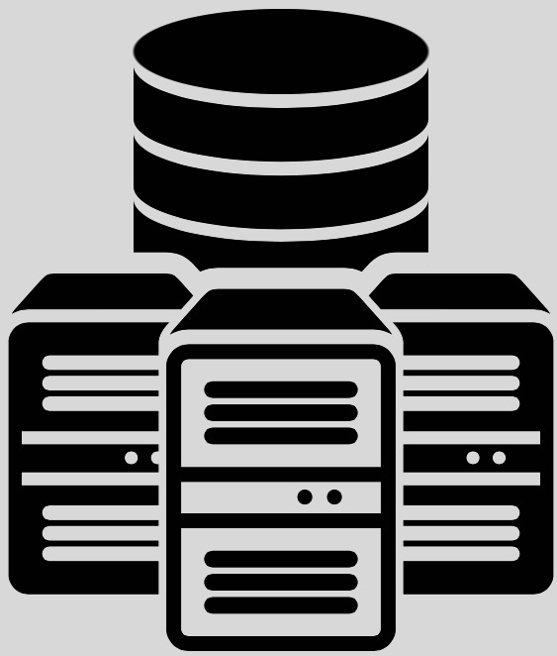

Cloud Platform Providers Offer a Set of Services and Easy Access
Different programming languages and a broad set of tools
Management APIs (RESTful)
Infrastructure as a Service (IaaS)
Windows VMs, Linux VMs, storage,
networking, automation, backup
site recovery, etc.
Platform as a Service (PaaS)
App service, media, database, Big Data, analytics, identity, API services, search, etc..
Service
Cloud infrastructure
Cloud platform
Source: Microsoft

Slide 46
4.1 Infrastructure as a Service
Advantages/Disadvantages
Examples:
Virtual Machines
Containers
Networking
Cross-Premises Connectivity
Setup and Configuration
High Availability

Slide 47
Infrastructure as a Service
Advantages
Disadvantages
Platform virtualization environment
Compute resources as a service
(VMs, networks, storage, load balancer, etc.)
Risk/availability
Examples:
Azure Virtual Machine
Amazon EC2
Google Compute Engine
Source: “Cloud Computing & Pricing,” Otto-von-Guericke-Universität Magdeburg, Robert Neuman, p.39​

Slide 48
Example: Azure Virtual Machines

Slide 49
Virtual Machines
Management
Image and VM size
New disk persisted in storage
Management portal
Windows Server
Boot VM from new disk
>_
Linux
Scripting
(Windows, Linux, and Mac)
Storage
General purpose
Optimized compute
Performance-optimized
Network-optimized
REST API
Optional: move back on premises
Comprehensive
networking
Source: Microsoft

Slide 50
Image Mobility
On-premises
Cloud
MyApp.vhd
Source: Microsoft

Slide 51

Virtual Machine Sizes
Network- optimized
Performance-optimized
Standard: General purpose compute
Virtual machine
sizes
Optimized compute
Basic:
General purpose compute
Source: Microsoft

Slide 52
Scale-up Options
A
D
G
Highest value
SSD storage Fast CPUs
Most memory Fastest CPUs
>80,000 IOPs
Premium storage
Highest value
Largest scale-up
Source: Microsoft

Slide 53
Scale-up Options
D
DV2
G
SSD Storage Fast CPUs
New generation of D family VMs
Most memory Fastest CPUs
>80,000 IOPs
Premium storage
Highest value
Largest scale-up
Source: Microsoft

Slide 54
Scale-up options
D
DV2
G
N
SSD Storage Fast CPUs
New generation of D family VMs
Most memory Fastest CPUs
GPU-enabled virtual machines
Highest value
Largest scale-up
Source: Microsoft

Slide 55
Example: Containers in the Cloud

Slide 56
Containers
What are they?
Unit of deployment
Isolated environment
Isolated collection of resources
App
A
App
A
App
B
App
framework
App
framework
App
framework
VM
Host OS
Guest OS
Guest OS
Guest OS
Hypervisor
What are the benefits?
Instant start-up
Repeatable and reliable execution
Physical server
App
A
App
A
App
B
App
B
App
B
Container
Container manager
App
framework
App
framework
Scenarios
Dev/test
Great for micro-services
Host OS
Physical server
Source: Microsoft
Notes:
When you see “containers” you probably think of Docker. For good reason, Docker has essentially defined the container market. To understand what Docker is let’s start by looking at Containers.
Containers are an isolated environment and isolated collection of resources that an application runs in. The resources are all the dependencies (DLL’s, configuration, etc.) that the application needs. Everything the application needs to run is in the container and it sees nothing on the host OS it is running on (except maybe an internet connection). Containers are therefore a unit of deployment.
<click>
A key benefit of containers is that they can startup almost instantly. The notion of “booting up” a guest OS doesn’t exist. The container just runs on top of the host OS. As a result, containers can startup almost instantly as compared to the startup period of a VM. And because everything is contained in this container, containers are easily repeatable and extremely reliable from one environment to the next. For example, I can run a container on my local dev box and have high confidence it will run the same when deployed to another machine, such as a VM running in Azure.
<Click>
As you can probably imagine, containers are extremely popular in dev/test scenarios. They are also great for micro-services.
<click>
To put a visual behind this, consider the architecture for a typical virtual machine. You have a physical server, hyper-visor and host OS. Then, each VM has it’s own guest OS that can be configured with applications and application frameworks. This is what you saw earlier in the presentation.
<click>
Now consider how a container is different. Physical Server with a host OS. However, notice there is not a guest OS. The container is essentially the application and it’s dependencies. Also notice that the app frameworks used by application A and application B are shared in this model. This is how instant startup is achieved.
Note that there are more instances of the same App running on the physical server. This underlines that a container is a scale unit besides being an isolation mechanism. In a production development you would use a cluster of hosts, and have containers spread of the hosts.

Slide 57

Container Ecosystem via Docker
Container run-time
Container images
Image repository
Linux
Docker API/client
Docker images
Docker hub
(trusted repositories)
Source: Microsoft

Slide 58
Example: Networking in the Cloud

Slide 59

Virtual Network Scenarios
Manage identity and access control with on-premise resources (e.g., on-premises Active Directory)
Enterprise app in the cloud requiring connectivity to on- premise resources
Enterprise identity and access control
Hybrid public/private cloud
Remote monitoring and troubleshooting of resources running in the cloud
Monitoring and management
Advanced connectivity requirements
Cloud deployments requiring IP addresses and direct connectivity across services
Source: Microsoft

Slide 60
Example: Cross-premises Connectivity in Azure

Slide 61
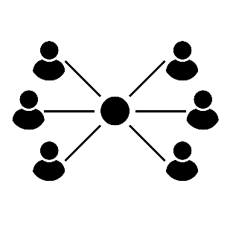


Cross-premises Connectivity in Azure
Site to site
Create a secure connection between your on-premises site and your virtual network
Point to site
Create a secure connection via VPN to your virtual network
ExpressRoute
Create a private connection between Azure data centers and infrastructure on your premises or in a colocation environment.
Connect at an ExpressRoute location (exchange provider facility)
Direct connect via a network service provider
Source: Microsoft

Slide 62
Setup and Configurations
Example: Azure Resource Manager, JSON files

Slide 63
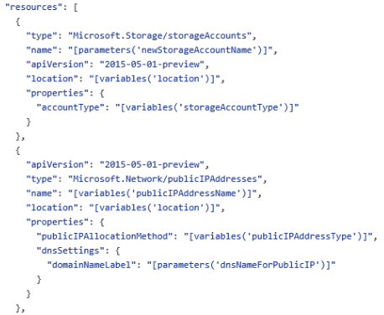
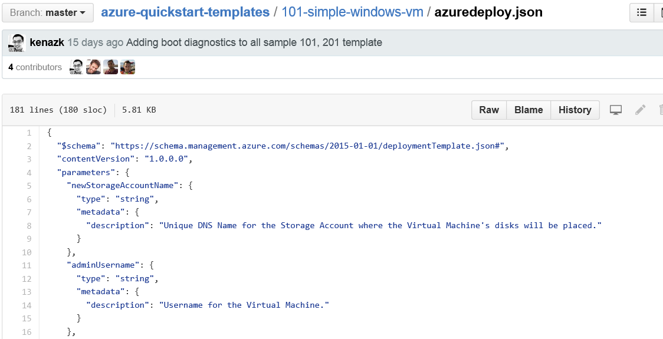
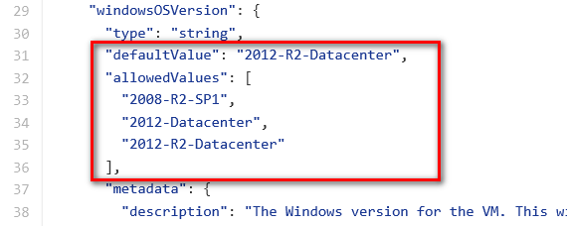
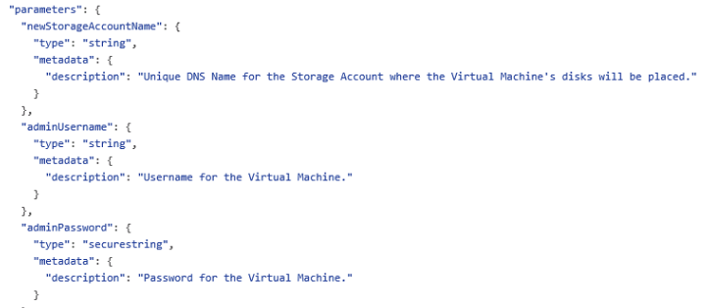
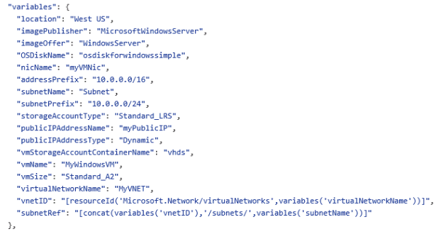
Example: Azure Resource Manager, JSON files
Schema, content version, parameters, variables, resources, and outputs
Source: Microsoft
Notes:
MONITOR ALS GROßES icon und bilder reinsetzen

Slide 64
High Availability in Microsoft Azure
Availability Sets
Fault and Update Domains
Virtual Machine Availability Sets

Slide 65
Availability Sets
Availability sets
Virtual
machine
Virtual
Machine
SLA high availability
Hardware and software
Windows and Linux
SQL server
primary
SQL server
secondary
SLA 99.95
Source: Microsoft

Slide 66
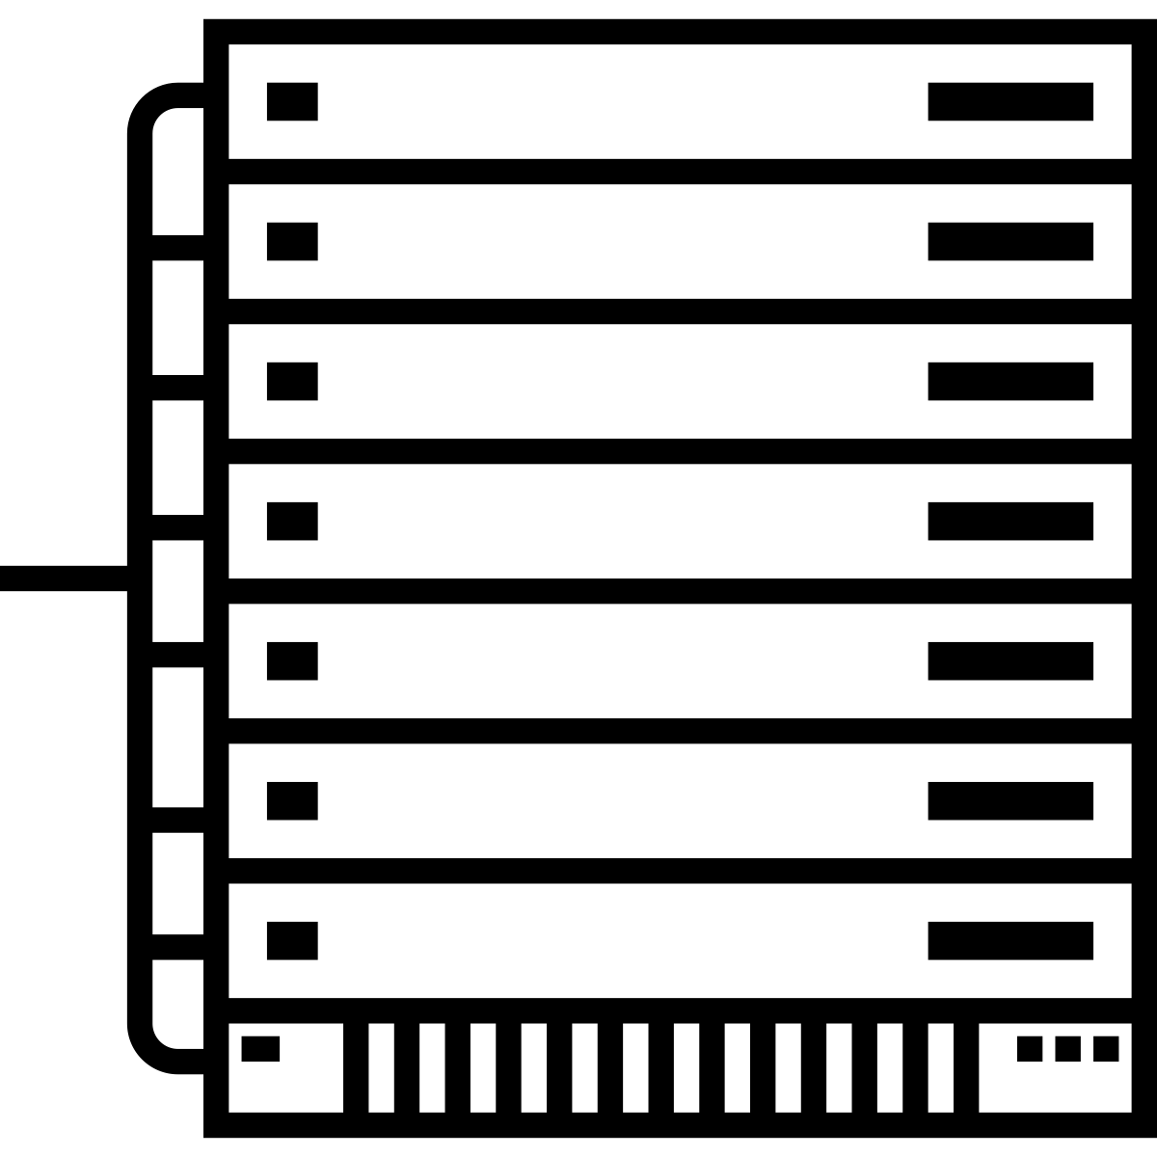


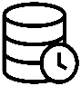



Availability Sets
Physical
machines
Power unit
rack switch
Source: Microsoft

Slide 67
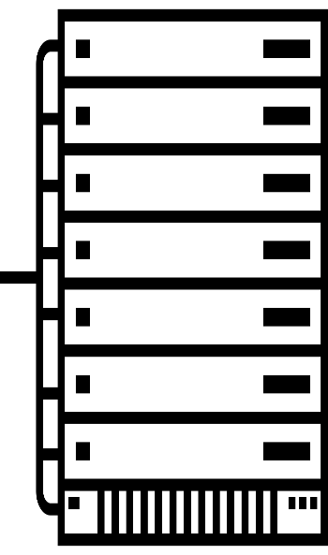


Availability Sets
VM 1
Availability sets
VM 1
VM 2
VM 2
Source: Microsoft

Slide 68
Availability Sets
VM 1
Availability sets
VM 1
VM 2
VM 2
Source: Microsoft

Slide 69
Availability Sets
VM 1
Availability sets
VM 1
VM 2
VM 2
Source: Microsoft

Slide 70
Fault and Update Domains
Fault domain
Fault domain
rack
rack
Web role
UD #1
UD #2
INSTANCE
INSTANCE
INSTANCE
INSTANCE
Worker role
UD #1
UD #2
INSTANCE
INSTANCE
INSTANCE
INSTANCE
Source: Microsoft

Slide 71
Virtual Machine Availability Sets
Update Domains are honored by host OS updates
Fault domain
Fault domain
rack
rack
Availability sets
Virtual machine
Virtual machine
IIS1
IIS2
UD #1
UD #2
Availability sets
Virtual Machine
Virtual Machine
SQL1
SQL2
UD #1
UD #2
Source: Microsoft

Slide 72
4.2 Platform as a Service
A platform for Running Applications
Example: Azure App Service
App Services are Built On Top of Each Other
Advantages over IaaS
Exercise: Platform as a Service

Slide 73
Platform as a Service
Advantages
Complete computing/solution stack
Automated deployment of applications
Ready for different technologies like Java, .Net, Node.js, Python
Service Provider (SP) responsible for
Hosting software
Disaster recovery
Failover
Backup management
Examples: Azure App Services, Cloud Services,
AWS Elastic Beanstalk, Lambda, Google App Engine
Disadvantages
Possible lock-in (depends on platform)
Source: “Cloud Computing & Pricing,” Otto-von-Guericke-Universität Magdeburg, Fakultät für Informatik, Robert Neuman, p. 37, 38

Slide 74
Example: Azure App Service

Slide 75




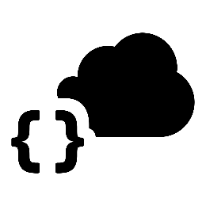
A Platform for Running Applications
Web apps
Mobile apps
Web apps that scale with the users needs
Services for mobile apps
LOGIC apps
API apps
Automated business processes across SaaS and on-premises
Easy to build and consume APIs in the cloud
Source: Microsoft

Slide 76
App Services Are Built on Top of Each Other
Deployment server(s)
File server
Blob storage
Publish endpoint
Application database
Front-end (IIS ARR)
Azure
load balancer
Metering
API endpoint
Runtime database
Source: Microsoft

Slide 77





Advantages over IaaS
Supports many languages and platforms
.NET, Node.js, Python, Ruby, and many more
Easy continuous deployment
Continuous delivery from third-party source control providers
Built-in Git repo
High availability
Automated scale out/in
Built-in load balancing
High security out of the box
Automatic OS patching
Source: Microsoft

Slide 78
Exercise: Platform as a Service
Host a Node.js, PHP, or ASP.NET Web Application in the Cloud: No Account Required
https://tryappservice.azure.com
You Can Get a Free Permanent Account at:
http://aka.ms/cloudforstudents

Slide 79
4.3 Database as a Service: SQL Database
Physical Machines Instead of Logical Servers
Example: Azure SQL Database Service
Notes:
Now let’s focus on Microsoft Azure SQL Database the PaaS service!

Slide 80




Physical Machines Instead of Logical Servers
Traditional SQL server
(Physical/VM)
machine
SQL database server
Endpoint
Source: Microsoft
Notes:
Slide Objectives:
Understand that while there are physical SQL Server boxes behind the scenes, when connecting to SQL Database, you are not connecting to a physical server, but to a TDS endpoint.
Transition:
The key to understanding SQL Database is understanding while SQL Database is SQL Server, we do not interact with them in the same physical manner.
Speaking Points:
In an on-premises environment, we typically have physical access to the actual SQL Server server.
In Microsoft Azure, we do not have physical access to the actual server.
Notes:
It is important that the attendee understands that it IS INDEED SQL Server at the platform layer. There are physical boxes running SQL Server 2012 Enterprise Edition. However, due to the nature of the Azure environment to provide the high-availability and scalability necessary, access to the physical boxes is currently not supported.

Slide 81
Example: Azure SQL Database Service

Slide 82
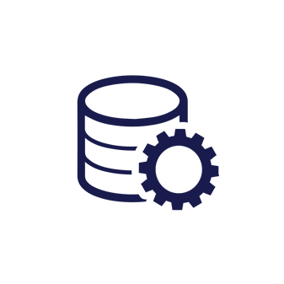
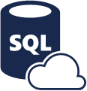

Example: SQL Database Service
Fully managed
SQL Server database technology “as a Service”
Automatic support for high availability,
data redundancy, backups, replication, and more
Source: Microsoft
Notes:
Slide Objectives:
Understand the overall concepts and benefits of SQL Database
Transition:
Let’s clear up any confusion and look at the basics of what SQL Database really is and some of its benefits.
Speaking Points:
The same great SQL Server database technology that you know, love, and use on-premises provided as a service
Enterprise-ready
Automatic support for High-Availability
Designed to scale on-demand to provide the same great elasticity
Notes:
High-availability – 3 copies of the database free for the cost of the one database. Always in sync. The cost to do this on-premises isn’t cheap. This is FREE in SQL Database.

Slide 83
How It Works – Architecture of the Service
Client layer
Services layer
Platform layer
PHP
SQL Server
applications
and tools
WCF data services
Provisioning
SQL Server
TDS
+
SSL
Billing and metering
SQL database fabric
ODBC
ADO.NET
Connection routing
Management services
Tabular data stream (TDS)
Applications communicate directly with SQL Database using TDS
Gateway between client layer and platform layer
Includes physical servers and servers that support the services layer
Source: Microsoft
Notes:
Now let’s focus on Microsoft Azure SQL Database the PaaS service!

Slide 84
How It Works – Architecture of the Service
Client layer
Services layer
Platform layer
PHP
SQL Server
applications
and tools
WCF data services
Provisioning
SQL Server
TDS
+
SSL
Billing and metering
SQL database fabric
ODBC
ADO.NET
Connection routing
Management services
Tabular data stream (TDS)
Microsoft Azure SQL Database
PaaS
Source: Microsoft
Notes:
Now let’s focus on Microsoft Azure SQL Database the PaaS service!

Slide 85
SQL Database Service in Comparison to SQL Server on IaaS
SQL database service
SQL Server on IaaS
When you want reduced overheads and possibly need elastic scale
Customer does not want to add additional IT resources for support and maintenance
Avoiding CAPEX and OPEX
Existing applications that require full-box product functionality
Ecosystem of IT resources for support and maintenance
Removing CAPEX
Source: Microsoft

Slide 86
Exercise:
Create an SQL Database Through the Azure Portal and Configure the Firewall to Allow Access to the Database
Access the Database from your Web Applications From the Last Exercise or from SQL Management Studio
3. You Can get a Free Permanent Account at:
http://aka.ms/cloudforstudents

Slide 87
4.4 Example for Cloud Use Case: Machine Learning

Slide 88

Machine Learning
Replacing human written code with supplying data
Finding patterns in data
“Subfield of computer science and statistics that deals with the construction and study of systems that can learn from data, rather than follow only explicitly programmed instructions”
-Wikipedia
Source: Microsoft

Slide 89


Why Learn?
1. Learn it when you can’t track it (e.g., AI gaming, robot control)
2. Learn it when you have to adapt/personalize (e.g., predictive typing)
3. Learn it when you can’t code it (e.g., recognizing speech/image/gestures)
4. Learn it when you can’t scale it (e.g., recommendations, spam & fraud detection)
Source: Microsoft

Slide 90
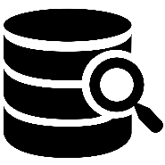
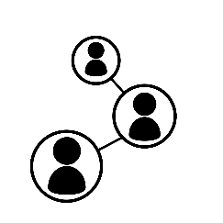










Using Past Data to Predict the Future
Churn analysis
Social network analysis
Recommen-dation engines
Location-based tracking and services
Machine learning & predictive analytics are core capabilities that are needed throughout your business!
Vision analytics
Weather forecasting for business planning
Legal discovery and document archiving
Equipment monitoring
Advertising analysis
Pricing analysis
Fraud detection
Personalized insurance
Source: Microsoft

Slide 91



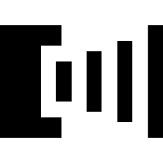

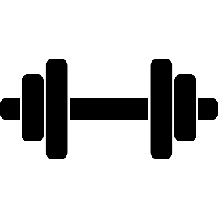

Machine Learning Flow
Manage
Define objective
Collect data
Publish
Integrate
Prepare data
Evaluate models
Train models
Source: Microsoft

Slide 92


Machine Learning Roles
Data scientist
A highly educated and skilled person who can solve complex data problems by employing deep expertise in scientific disciplines (mathematics, statistics, or computer science)
Data professional
A skilled person who creates or maintains data systems and data solutions, or implements predictive modeling Roles: Database Administrator, Database Developer, or BI Developer
Software developer
A skilled person who designs and develops programming logic, and can apply machine learning to integrate predictive functionality into applications
Source: Microsoft

Slide 93

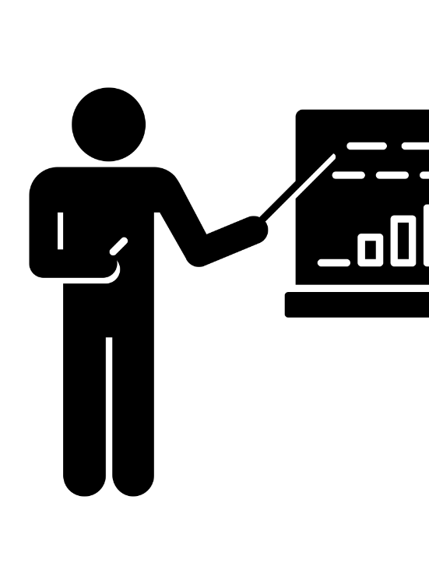
Challenges in Machine Learning
Expensive
Traditional approach
Guessing
Rules of thumb
Trial and error
Strategic change
High competition
Isolated data
Tool chaos
Consequences
Lost opportunities
Expensive operative mistakes
Lots of
buzzwords
New markets
Complexity
DATA SCIENTIST
Source: Microsoft

Slide 94
Example of an ML Cloud Service: Azure Machine Learning

Slide 95



Azure Machine Learning: One Solution for Machine Learning
Business users easily access results from anywhere, on any device
Web apps
Mobile apps
Power BI/dashboards
ML API service Developer
Azure portal & ML API service
ML studio
HDInsight
Azure storage
Azure ops team
Data scientist
Desktop data
Source: Microsoft

Slide 96
Azure Machine Learning: One Solution for Machine Learning
Business users easily access results from anywhere, on any device
Web apps
Mobile apps
Power BI/dashboards
ML API service and the application developer
Tested models available as a URL that can be called up from any endpoint
Azure portal & ML API service and the Azure ops team
Create ML Studio workspace
Assign storage account(s)
Monitor ML consumption
See alerts when model is ready
Deploy models to Web service
ML studio and the data professional
Access and prepare data
Create, test, and train models
Collaborate
One click to stage for production via the API service
HDInsight
Azure Storage
Data Scientist
Desktop Data
Source: Microsoft

Slide 97
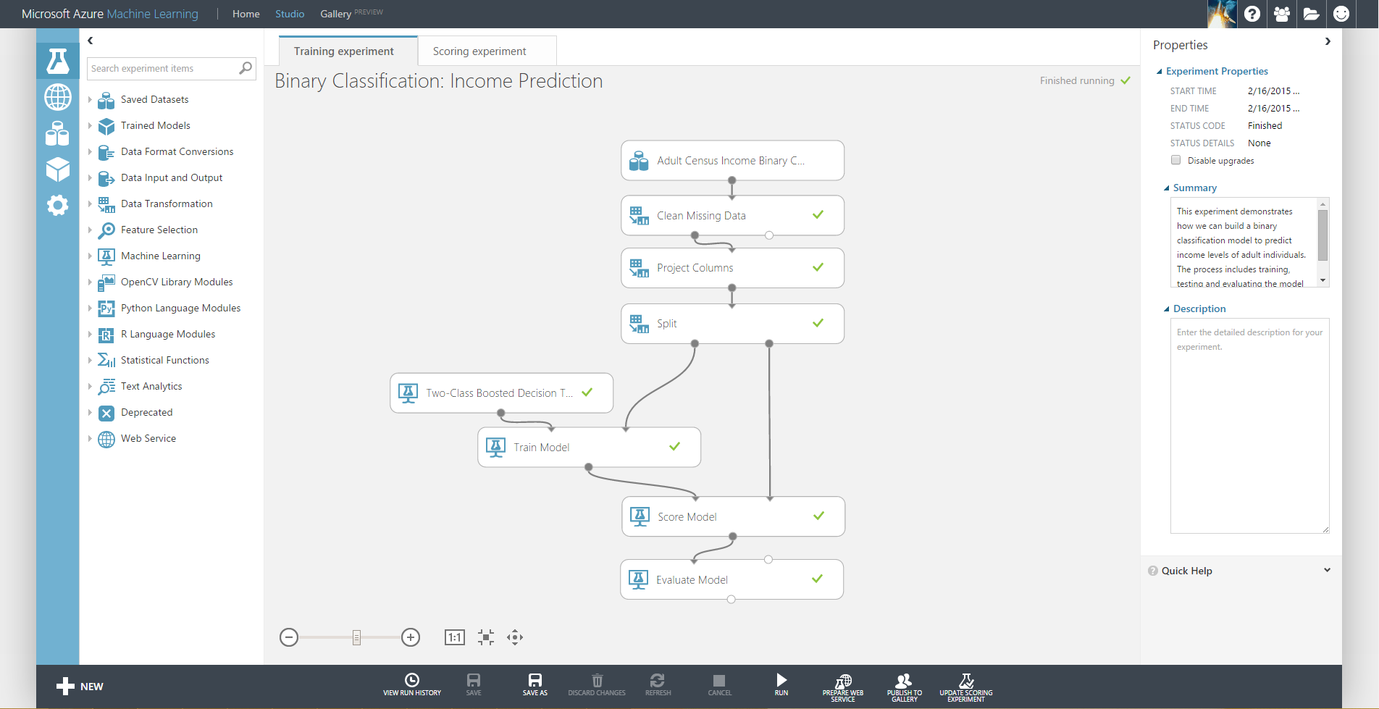
Azure Machine Learning Studio
https://studio.azureml.net/
Source: Microsoft, Image: http://news.microsoft.com/?attachment_id=159361

Slide 98
Summary
Machine learning is a subfield of computer science and statistics that deals
with the construction and study of systems that can learn from data
Machine learning on platforms like Microsoft Azure has advantages:
Fully managed ► no hardware or software to buy
Integrated ► drag, drop, connect, and configure
Best-in-class algorithms ► proven solutions from Xbox and Bing
R built in ► use over 400 R packages or bring your own R or Python code
Deploy in minutes ► operationalize with a click
Through the cloud, machine learning is now approachable to developers
Source: Microsoft

Slide 99
5 Designing Cloud Applications

Slide 100






Build for Redundancy
Geo-replication
Storage redundancy options
Caching with high availability options
Redundancy
Text
Failover with a traffic manager/ load balancer
Load-balanced
services and virtual machines
Built-in redundancy
in virtual network
gateways for some
providers
Source: Microsoft

Slide 101



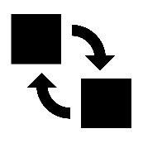
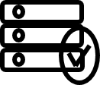


Resiliency in the Cloud
Auto recovery – Service Healing
Fault domain – prevent single point of failure
Virtual machine availability set – fault domain and rolling host updates
Upgrade domain – service availability during upgrade
Deployment slots and VIP swap
Emulator, IntelliTrace, and enhanced diagnostics
Telemetry – native and third-party support
Source: Microsoft
Notes:
Speaker notes:
Explain how Fabric Controller(FC) initiates auto recovery of crashed or nonresponsive instances; The FC monitors role instances, virtual and physical machines and initiates recovery action if any one of them deemed unhealthy. A Recovery action includes restarting a role instance, recycling a virtual machine or performing reboot of a physical machine. Virtual machines running in a defective physical machine are recovered to another healthy server.
Explain HA through fault domain to scatter instances across racks.
Explain HA through availability sets; putting two or more VMs in availability sets guarantees that your VMs are spread across multiple racks in the Windows Azure Data Centers for redundancy and hence making your service highly available. Without availability sets the FC would have no idea that two or machines are serving the same service and could reasonably take them down at the same time for host OS updates.
Explain how upgrade domain helps continued service availability during application upgrade. Upgrade domain avoids shutting down all instances at the same time during an upgrade.
Explain how Web App Deployment Slots and Cloud Service VIP swap allow promoting staging to production and manage dev/test environments with DevOps mindset. If the changes swapped into the production slot are not as you expected, you can perform the same swap immediately to get your "last known good site" back.
Explain first party and third party support for telemetry.
Explain how to make your application resilient by adding robust transient fault handling logic using the Transient Fault Handling Application block in your code.

Slide 102






Making Applications Failsafe
Take advantage of cloud platform features
Transient errors
Avoid single point failure
Graceful degradation
Failure mode analysis
Eliminate human factors
Source: Microsoft
Notes:
[click]
It depends, but…. [click]

Slide 103
Scaling in the Cloud
Scale-up by choosing different VM sizes
Scale-out by using multiple service entities
Scale-out by adding more instances
CDN to distribute user traffic
Auto-scale with autoscaling
Caching to offset server workloads
Source: Microsoft

Slide 104
6 Cloud Metrics

Slide 105
Cloud Quality Metrics
MTBF (mean time between failure)
Availability (see CAP theorem)
Part of a service contract
Service Level Agreements (SLAs)
Throughput
Measurable details
Response time
Start-up time (see lecture cloud scaling & performance)
Source: Microsoft

Slide 106
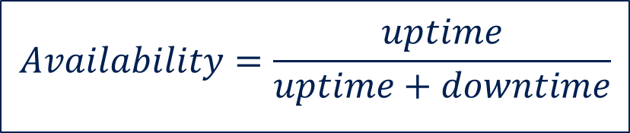
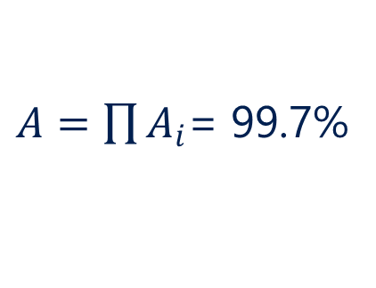
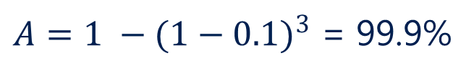
Availability
$$Availability=\frac{uptime}{uptime+downtime}$$
Redundancy
Composition
A (90%)
A (99.9%)
B (99.9%)
C (99.9%)
B (90%)
$A=1 −{(1−0.1)}^{3}$ = 99.9%
C (90%)
$A=\prod{A_{i}}$= 99.7%
Source: Microsoft

Slide 107
Meaning of 9s
Service availability (%)
System type
Annualized down minutes
Quarterly
down
minutes
Monthly
down minutes
Practical meaning
FAA rating
90
Unmanaged
52,596.00
13,149.00
4,383.00
Down 5 weeks per year
99
Managed
5,259.60
1,314.90
438.30
Down 4 days per year
ROUTINE
99.9
Well managed
525.96
131.49
43.83
Down 9 hours per year
ESSENTIAL
99.99
Fault-tolerant
52.60
13.12
4.38
Down 1 hour per year
Source: Microsoft based on Generic Requirements for Operation Systems Platform Reliability, Telcordia Technologies System Documentation, GR-2841-CORE, and Federation Aviation Administration Handbook: Reliability, Maintainability, and Availability (RMA) Handbook, FAA-HDBK-006A, January 7, 2008

Slide 108
Meaning of 9s
Service availability (%)
System type
Annualized down minutes
Quarterly
down
minutes
Monthly
down minutes
Practical meaning
FAA rating
99.999
High
availability
5.26
1.31
0.44
Down 5 minutes per year
CRITICAL
99.9999
Very high availability
0.53
0.13
0.04
Down 30 seconds
per year
99.99999
Ultra
availability
0.05
0.01
-
Down 3 seconds
per year
SAFETY-CRITICAL
Source: Microsoft based on Generic Requirements for Operation Systems Platform Reliability, Telcordia Technologies System Documentation, GR-2841-CORE. and
Federation Aviation Administration Handbook: Reliability, Maintainability, and Availability (RMA) Handbook, FAA-HDBK-006A, January 7, 2008

Slide 109
7 Cloud Computing Scenarios

Slide 110
Scenarios to Get Started
Dev/test Full test and dev environments in minutes
Identity Synchronize all your identities through Azure AD to control access to apps, data, and services
Lift & shift Take existing workloads and run them in a certified instance
Cloud
Web apps Take your Web apps to the cloud using inexpensive websites
Storage Archive key data in inexpensive cloud storage
Big Data Process key data into business intelligence using Hadoop or machine learning
Source: Microsoft

Slide 111










Full Dev/Test Environments
Build
Production
Cloud source control & ALM
Master branch
GIT/TFS
Staging
Check-in
{ }
{ }
Test branch
?
!
Developers
Dev/test
Source: Microsoft

Slide 112



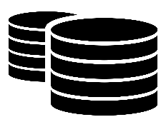


Lift and Shift
Lift and shift
Database server
VM
Database server VM
Corporate
network
Application VM
Application VM
Storage
Archive
key data inexpensively
DOCX
VIDEO
DB
Source: Microsoft

Slide 113





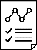

Big Data
Iterative exploration – process key data into business intelligence using Hadoop
Process
Visualization
and reporting tools
Input
Output
Results
Source: Microsoft
Notes:
Speaker notes:
Iterative exploration
The source data files(log files, email messages, tweets, and more) are loaded into the cluster, processed by one or more queries within HDInsight, and the output is consumed by the chosen reporting and visualization tools. The cycle repeats using the same data until useful insights have been found, or it becomes clear that there is no useful information available from the data—in which case you might choose to restart the process with a different source dataset.

Slide 114
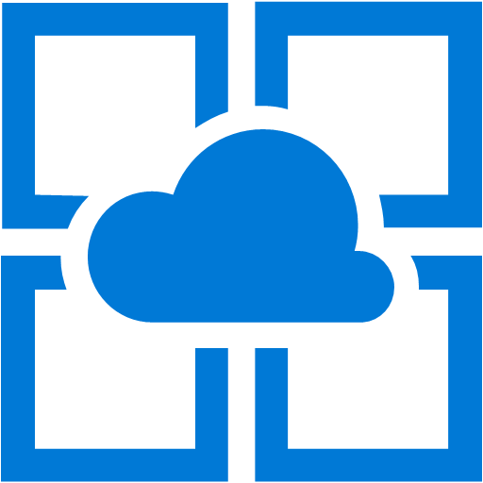
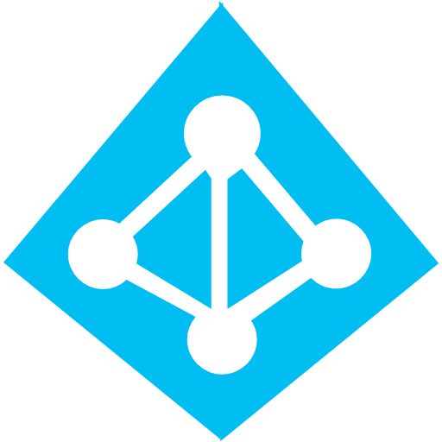


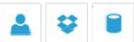
Identity as a Service with Azure Active Directory
SaaS
Active Directory
Active Directory
Synchronize and
consolidate
identities
Custom LOB apps
ISV/CSV apps
Azure App Service and non-MS cloud-based apps
PCs and devices
Source: Microsoft
Notes:
Speaker notes:
Identity as a Service; Control and protect your apps, data and services in Azure together with assets in non-MS cloud using a single AD account.
Consolidate all your identities using one account for single sign-on to any cloud and on-premises services, using your favorite device, including iOS, Mac OS X, Android, and Windows devices.
As a developer you must also need to understand implications of extending your credentials in on-premises Active Directory to Azure Active Directory to protect your assets in on-premises and in the cloud.

Slide 115





Web Apps
On-premises /
hosting services
IIS/SQL Server-based Web apps
SQL Server
SQL
SQL
IIS
MySQL
My
My
Non-IIS open source
Web apps
Source: Microsoft
Notes:
Speaker notes:
You can easily move your existing IIS based web apps including SQL Server databases to Azure App Service easily with a migration tool provided by Microsoft called Azure App Service Migration Assistant.
If your open source web app’s framework is supported on App Service, the languages and frameworks needed by your application are configured for you automatically. Migrate an existing application or create a new one from the Application Gallery.
Consider using Azure Cloud Services or IaaS Virtual Machines if you are unable to migrate your application via Migration Assistant or your open source web app’s framework isn’t supported on App Service.
Other notes:
Windows Server 2003 will reach end of support on July 14th 2015. If you are currently hosting your websites on an IIS server that is Windows Server 2003, Web Apps is a low-risk, low-cost, and low-friction way to keep your websites online, and Web Apps Migration Assistant can help automate the migration process for you.
Moving to Web Apps require less time and IT expertise to configure and secure your apps compared to apps running in VM environment.
Web Apps require no maintenance effort on your part to patch, update, and manage underlying VM environment.

Slide 116
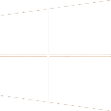

References and Credits
This lecture is based on the following presentations and lectures:
Otto von Guericke Universität Magdeburg
Dr. Robert Neumann, „Cloud Computing & Pricing“, 2012
Jan Hentschel, „Cloud Computing“, 2012
Christian Fellner, „Cloud Computing“, 2012
Prof. Dr. Andreas Schmietendorf, “Service Engineering”, 2012
Frankfurt University of Applied Sciences
Damir Dobric, “Cloud Computing”, 2015
Hochschule Mannheim
​
Prof. Dr. Christian Baun​, “Cluster-, Grid- und Cloud-Computing”, 2010
Microsoft Corporation

